Slide 1

Jollof Swap
A Decentralized Exchange on the Findora Blockchain
www.jollofswap.com
https://github.com/JollofSwap

Slide 2
Introduction
Jollof Swap is an on-chain system of smart contracts on the Findora blockchain, implementing an automated liquidity protocol based on a “constant product formula”. Each pair stores pooled reserves of two assets, and provides liquidity for those two assets, maintaining the invariant that the product of the reserves cannot decrease. Traders pay a 30-basis-point fee on trades, which goes to liquidity providers. The contracts are non-upgradeable.

Slide 3
Most significantly, it enables the creation of arbitrary ERC20/ERC20 pairs.
It also provides a hardened price oracle that accumulates the relative price of the two assets at the beginning of each block. This allows other contracts on Findora to estimate the average price for the two assets over arbitrary intervals.
Finally, it enables “flash swaps” where users can receive assets freely and use them elsewhere on the chain, only paying for (or returning) those assets at the end of the transaction.

Slide 4

WHY JOLLOF?
Jollof, or jollof rice, is a rice dish from West Africa. The dish is typically made with long-grain rice, tomatoes, onions, spices, vegetables and meat in a single pot, although its ingredients and preparation methods vary across different regions.

Slide 5
Jollof Swap allows liquidity providers to create pair contracts for any two token. A proliferation of pairs between arbitrary ERC-20s could make it somewhat more difficult to find the best path to trade a particular pair, but routing can be handled at a higher layer (either off-chain or through an on-chain router or aggregator).

Slide 6
Jollof Swap improves this oracle functionality by measuring and recording the price before the first trade of each block (or equivalently, after the last trade of the previous block). This price is more difficult to manipulate than prices during a block.

Slide 7
Protocol fee
Jollof Swap includes a 0.05% protocol fee that can be turned on and off. If turned on, this fee would be sent to a feeTo address specified in the factory contract. Initially, feeTo is not set, and no fee is collected. A pre-specified address—feeToSetter—can call the setFeeTo function on the Factory Contract, setting feeTo to a different value. feeToSetter can also call the setFeeToSetter to change the feeToSetter address itself.

Slide 8
If the feeTo address is set, the protocol will begin charging a 5-basis-point fee, which is taken as a One-sixth cut of the 30-basis-point fees earned by liquidity providers. That is, traders will continue to pay a 0.30% fee on all trades; 83.3% of that fee (0.25% of the amount traded) will go to liquidity providers, and 16.6% of that fee (0.05% of the amount traded) will go to the feeTo address.

Slide 9
Implementation
Solidity: Jollof Swap is implemented in Solidity, which has the ability to interpret the return values of non-standard ERC-20 tokens, as well as access to new opcodes such as chainId via inline assembly.
MetaMask
Remix Ethereum

Slide 10
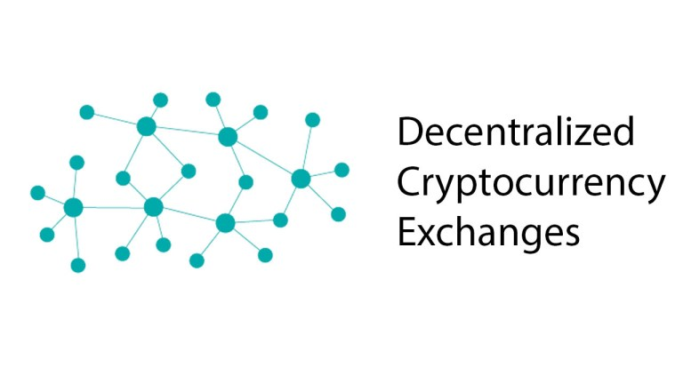
THE NEED FOR A DEX ON FINDORA

Slide 11
A decentralized exchange (DEX) is a cryptocurrency exchange that operates in a decentralized manner, without the need for a centralized authority.
Decentralized exchanges are operated by code and allow peer-to-peer trading of cryptocurrencies. They are generally non-custodial, meaning you hold the private keys to your wallets. Your assets remain your responsibility.
Findora Privacy Feature.

Slide 12
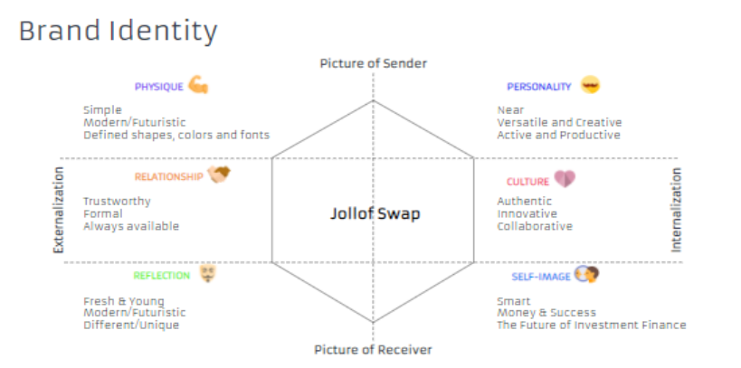

Slide 13
Future Upgrades
is a decentralized protocol dedicated to bringing automatic asset allocation and aggregation to the interest-bearing tokens economy. This protocol bundles crypto-assets (FRA, WBTC, and stablecoins) into tokenized baskets that are programmed to automatically rebalance funds according to different management strategies.

Slide 14
References
Hayden Adams. 2018. url: https://hackmd.io/@477aQ9OrQTCbVR3fq1Qzxg/HJ9jLsfTz? type=view.
Fabian Vogelsteller and Vitalik Buterin. Nov. 2015. url: https://eips.ethereum. org/EIPS/eip-20.

